Slide 1
React Context Demo

Slide 2
React’s Context API allows you to manage global application state in your React apps without resorting to props drilling.

Slide 3
We want to build a “theme toggler” component which toggles between light mode and dark mode for our React app. Every component has to have access to the current theme mode so they can be styled accordingly.
Normally,we would provide the current theme mode to all the components through props and update the current theme using state:

Slide 4
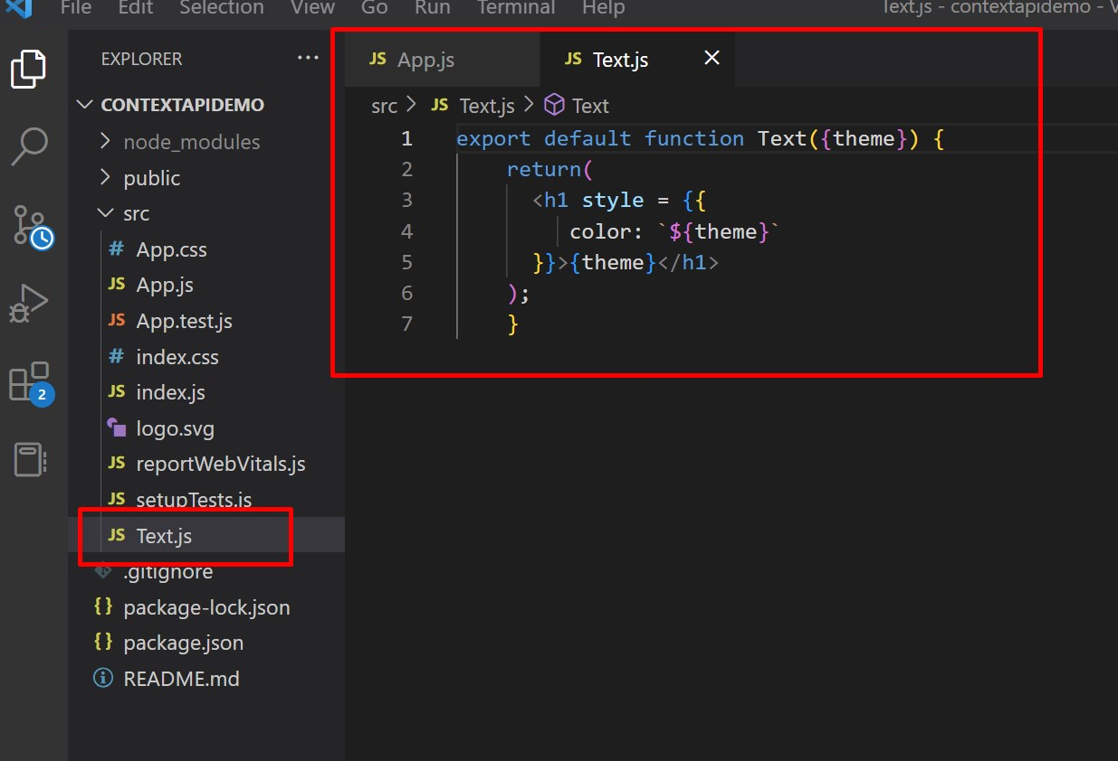
In the src folder, create new file Text.js

Slide 5
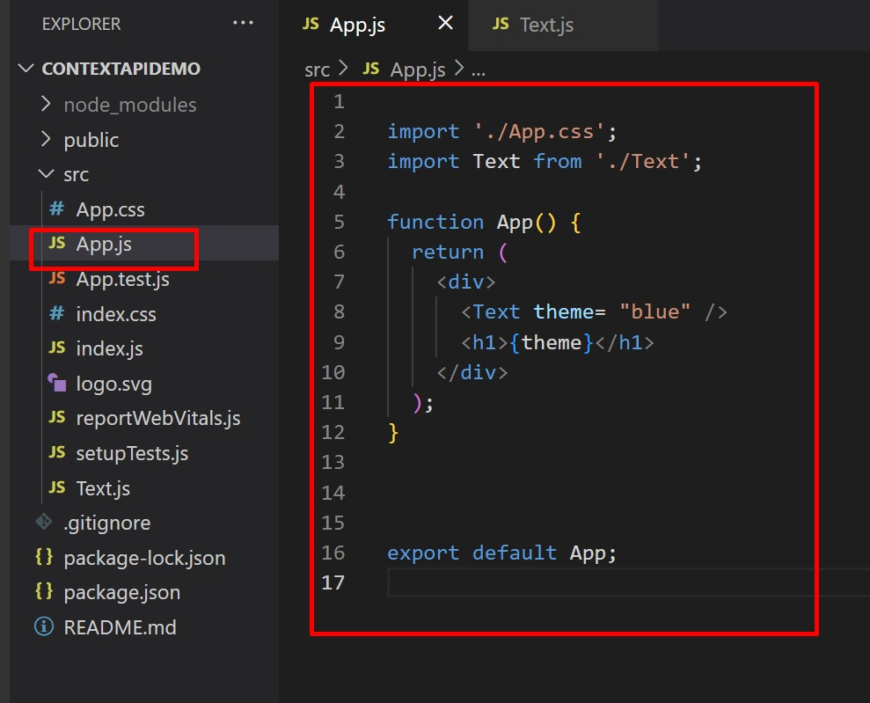
Modify the App.js.

Slide 6
In the code sample above, we created Text Component which renders an h1 element. The color of the h1 element depends on the current theme mode. Currently, the theme is blue. We can toggle between blue and red themes by using state.

Slide 7
We will create a state called “theme” using the useState hook. The useState hook will return the current value of the theme and a function which we can use to update the theme.
We will also add a button element to our App component. This button will be used to toggle the themes and it needs a click event handler.
Then we will set the new theme to Red if the current theme is Blue, and vice versa. We use ternary operator for this.

Slide 8
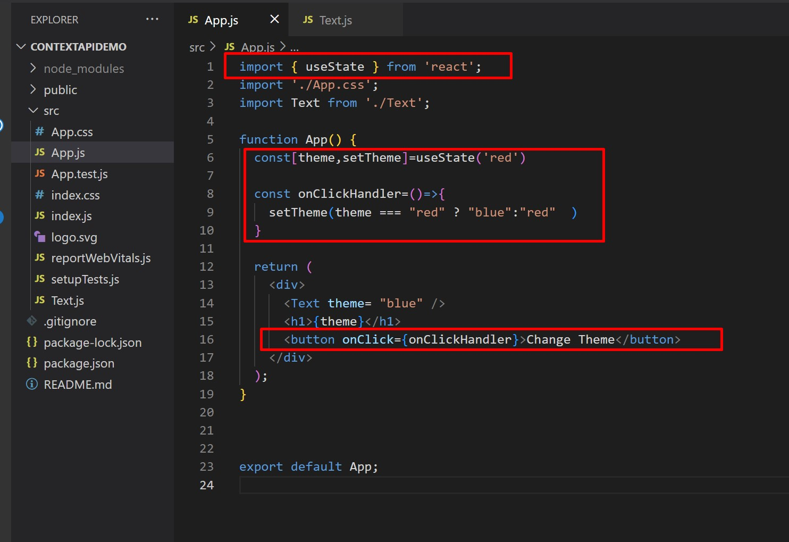
Modify the App Component as shown here

Slide 9
Run Application. Check output.

Slide 10
Introducing Context API
Context provides a way to pass data through the component tree without having to pass props down manually at every level.
It provides a way for you to make particular data available to all components throughout the component tree no matter how deeply nested that component may be.

Slide 11
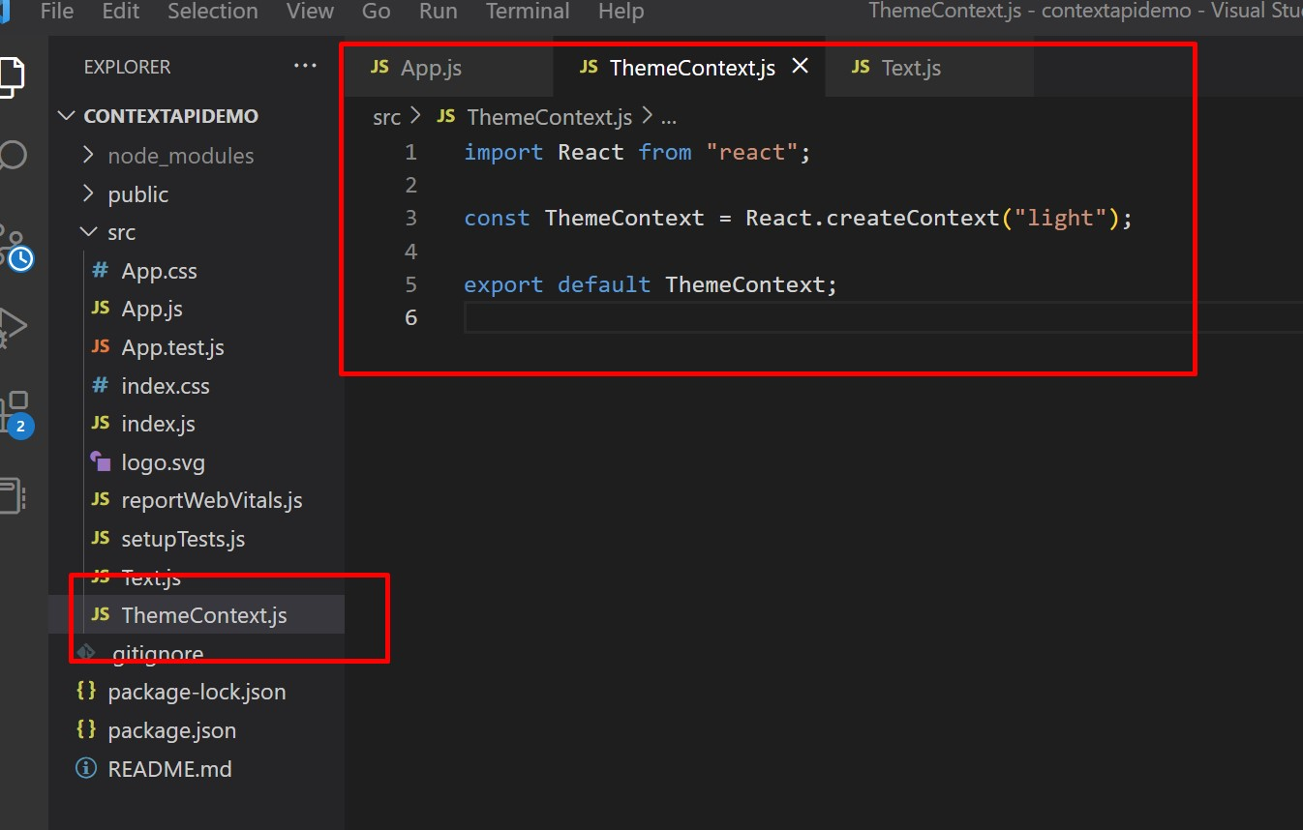
Create a new file → ThemeContext.js

Slide 12
To make this context available to all our React components, we have to use a Provider.
According to React documentation, every context object comes with a Provider React component that allows consuming components to subscribe to context changes.
It is the provider that allows the context to be consumed by other components.

Slide 13
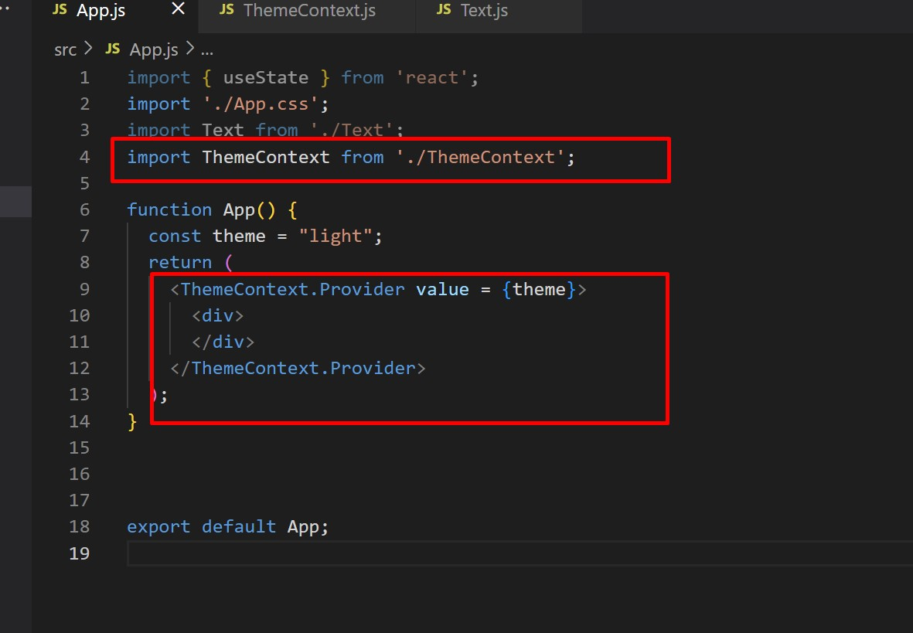
Go to App.js→import ThemeContext and use Provider as shown here

Slide 14
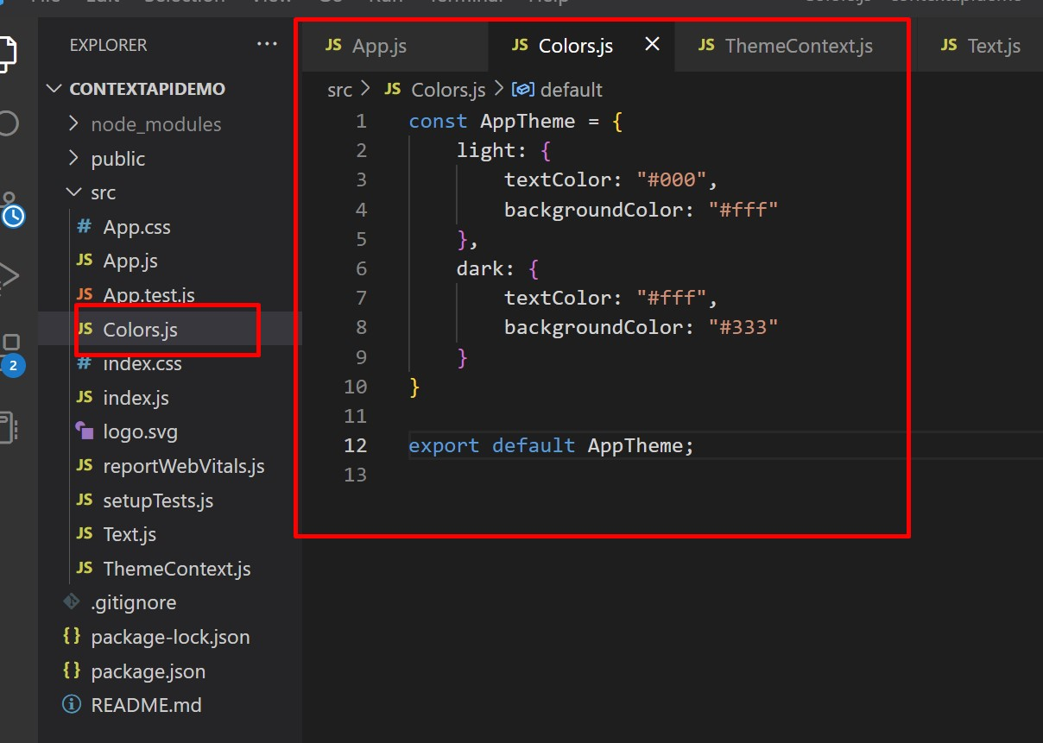
Create a new file➔Colors.js

Slide 15
Now,we will create 3 React components.
Header
ThemeToggler
MainWithFunc

Slide 16
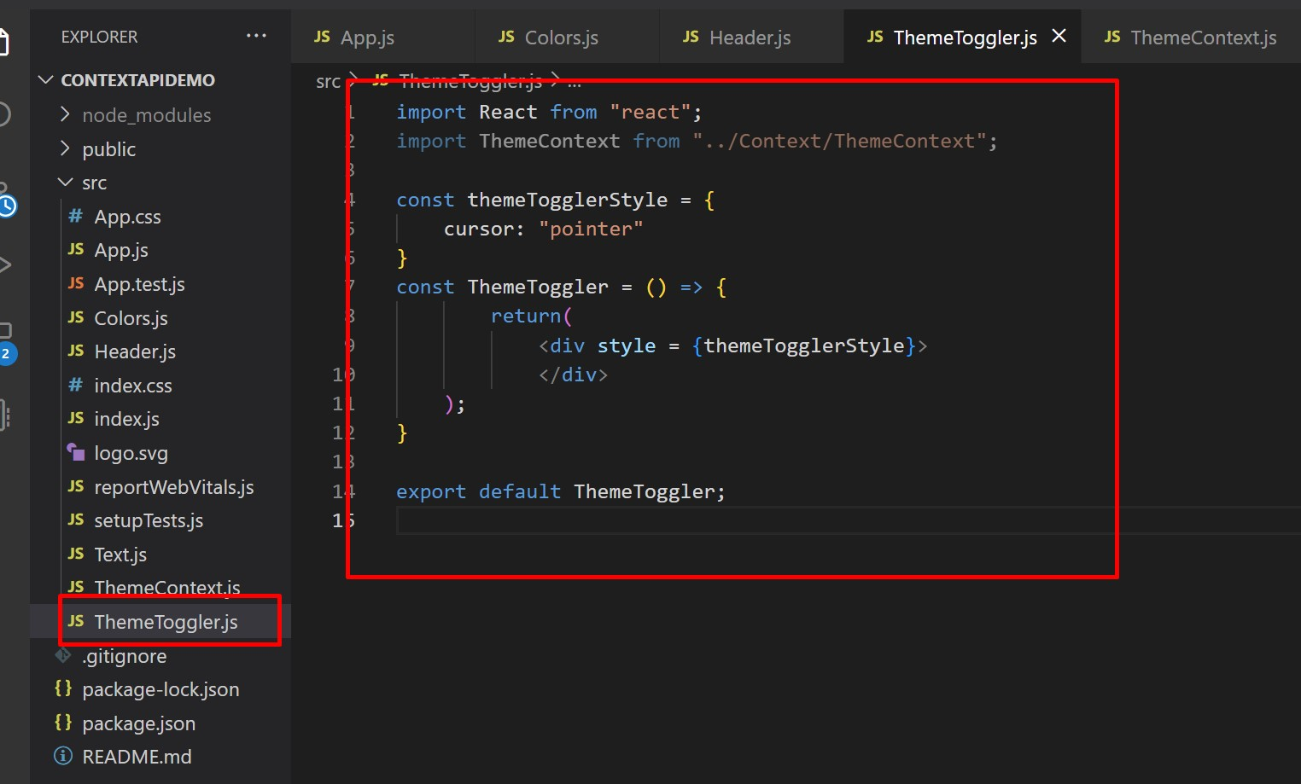
Prepare ThemeToggler.js

Slide 17
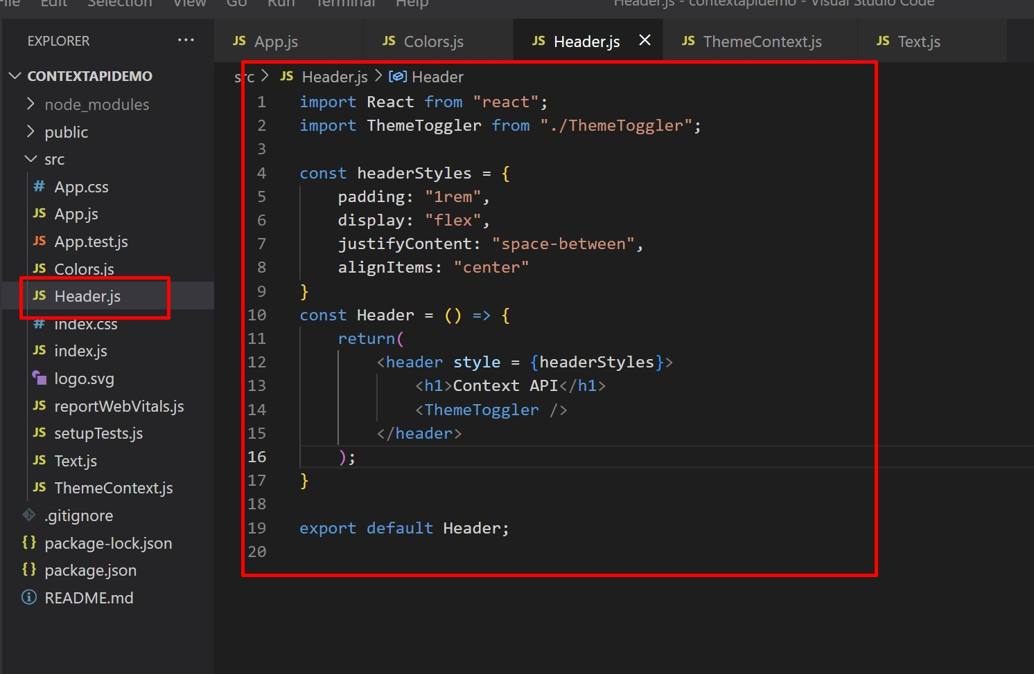
Prepare Header.js

Slide 18
Here,we will use the value of our ThemeContext. We have two methods of writing components in React: through functions or classes.
The process of use context in both methods is different.
We will see both of them. We create two components here MainWithClass and MainWithFunction.

Slide 19
There are two methods to work with Context API with class-based components:
The first method is through Class.contextType
To use this method,we assign the context object from our ThemeContext to contextType property of our class.
After that, we will be able to access the context value using this.context
You can also reference this in any of the lifecycle methods and even the render method.
After assigning ThemeContext to the contextType property of our class. I saved the current theme object in the currentTheme variable.
Then, we grab the colors from the currentTheme variable and use them to style markup.

Slide 20
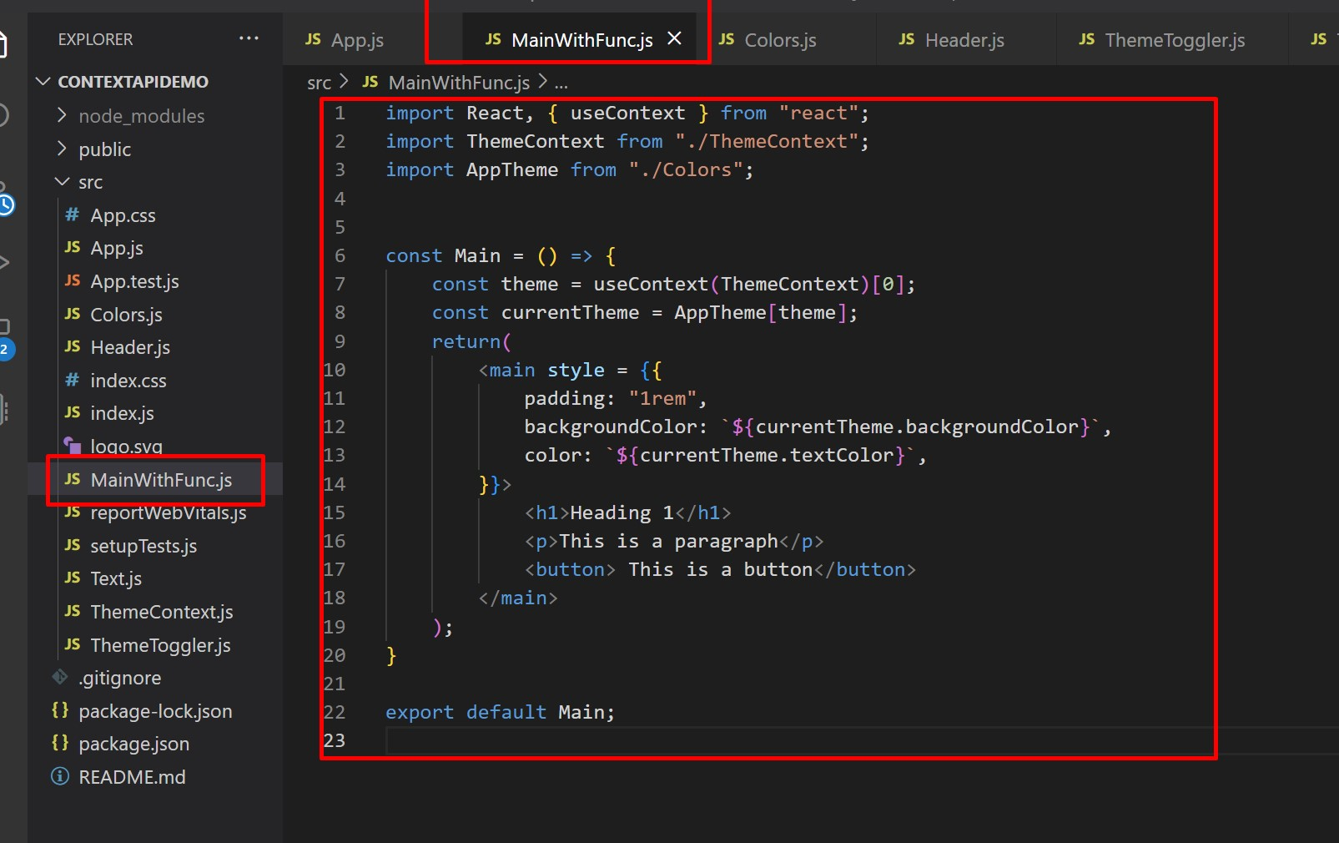
Create New File→MainWithFunc.js

Slide 21
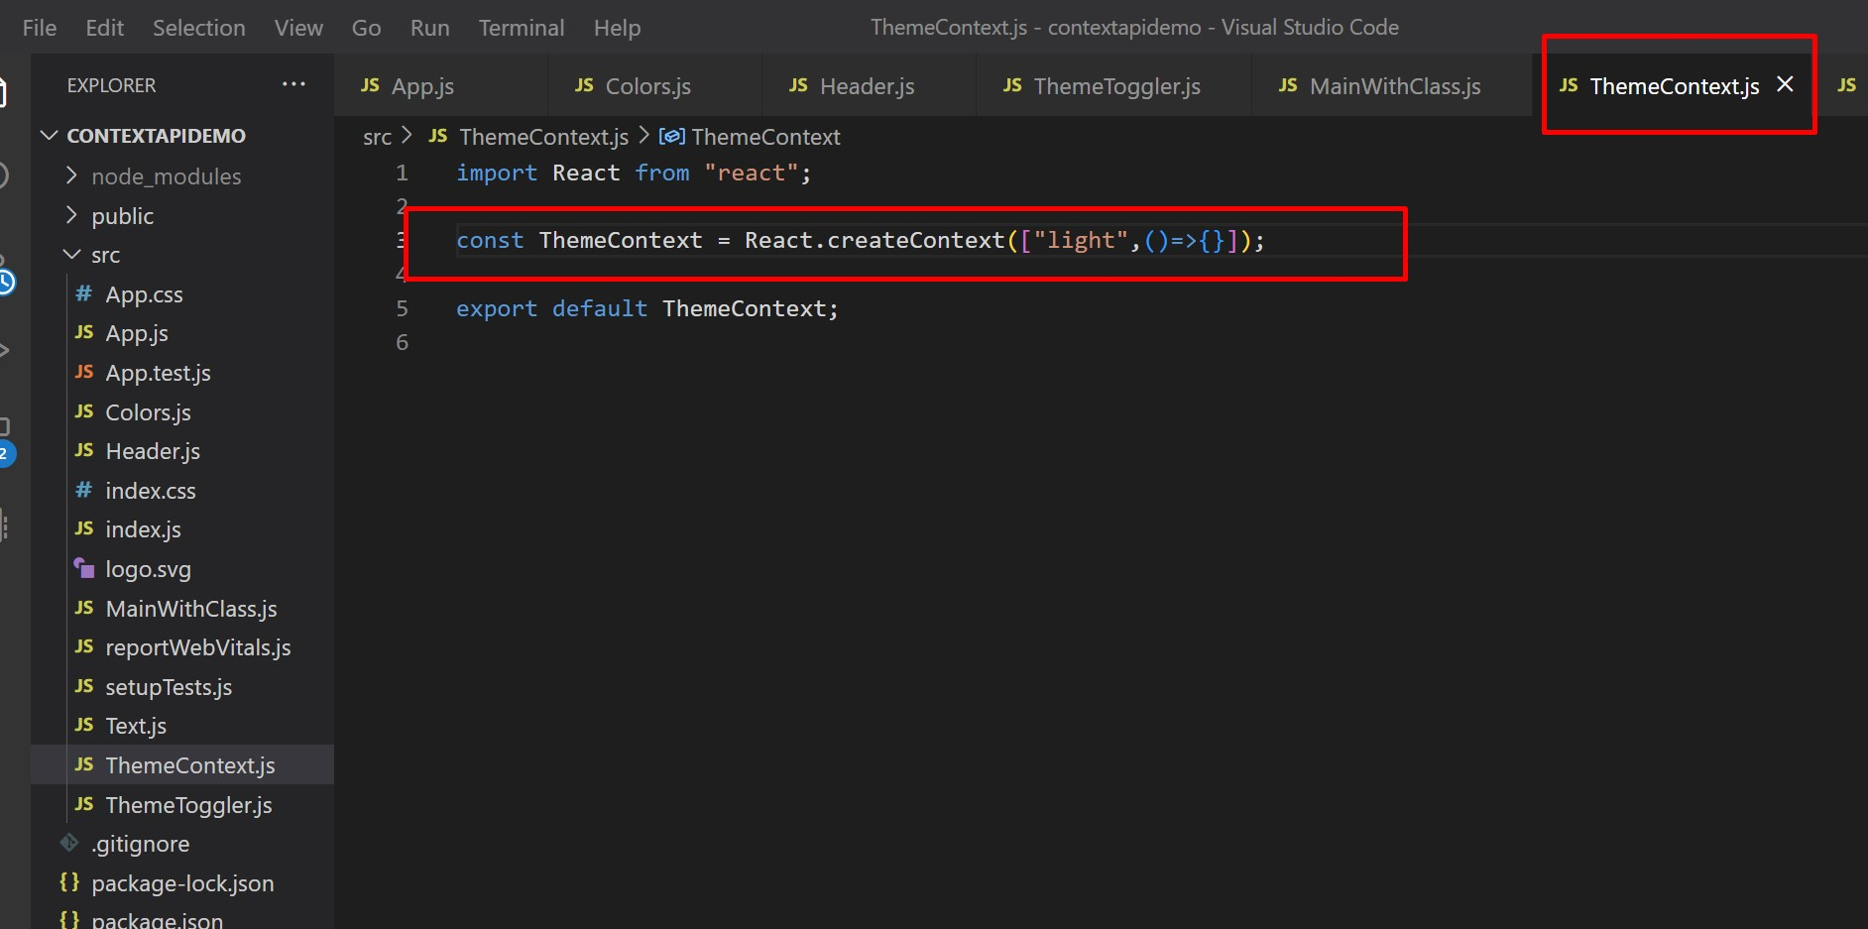
Modify ThemeContext.js file as shown here…

Slide 22
Here we passed an array to the React.createContext() function. The first element in the array is the current theme mode and second element is the function that would be used to update the theme.

Slide 23
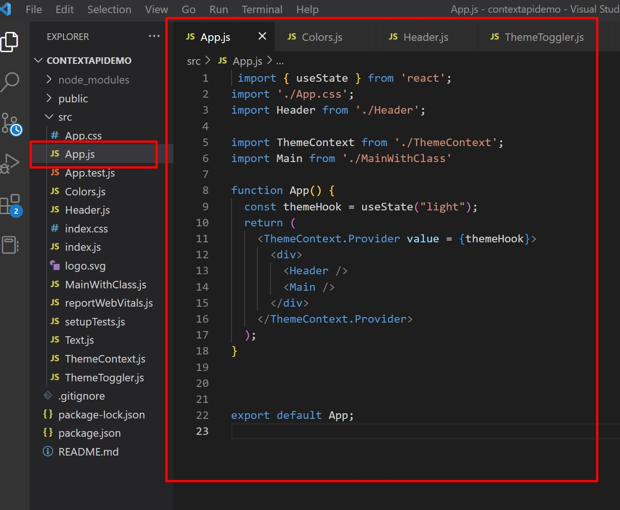
Modify App.js as shown here

Slide 24
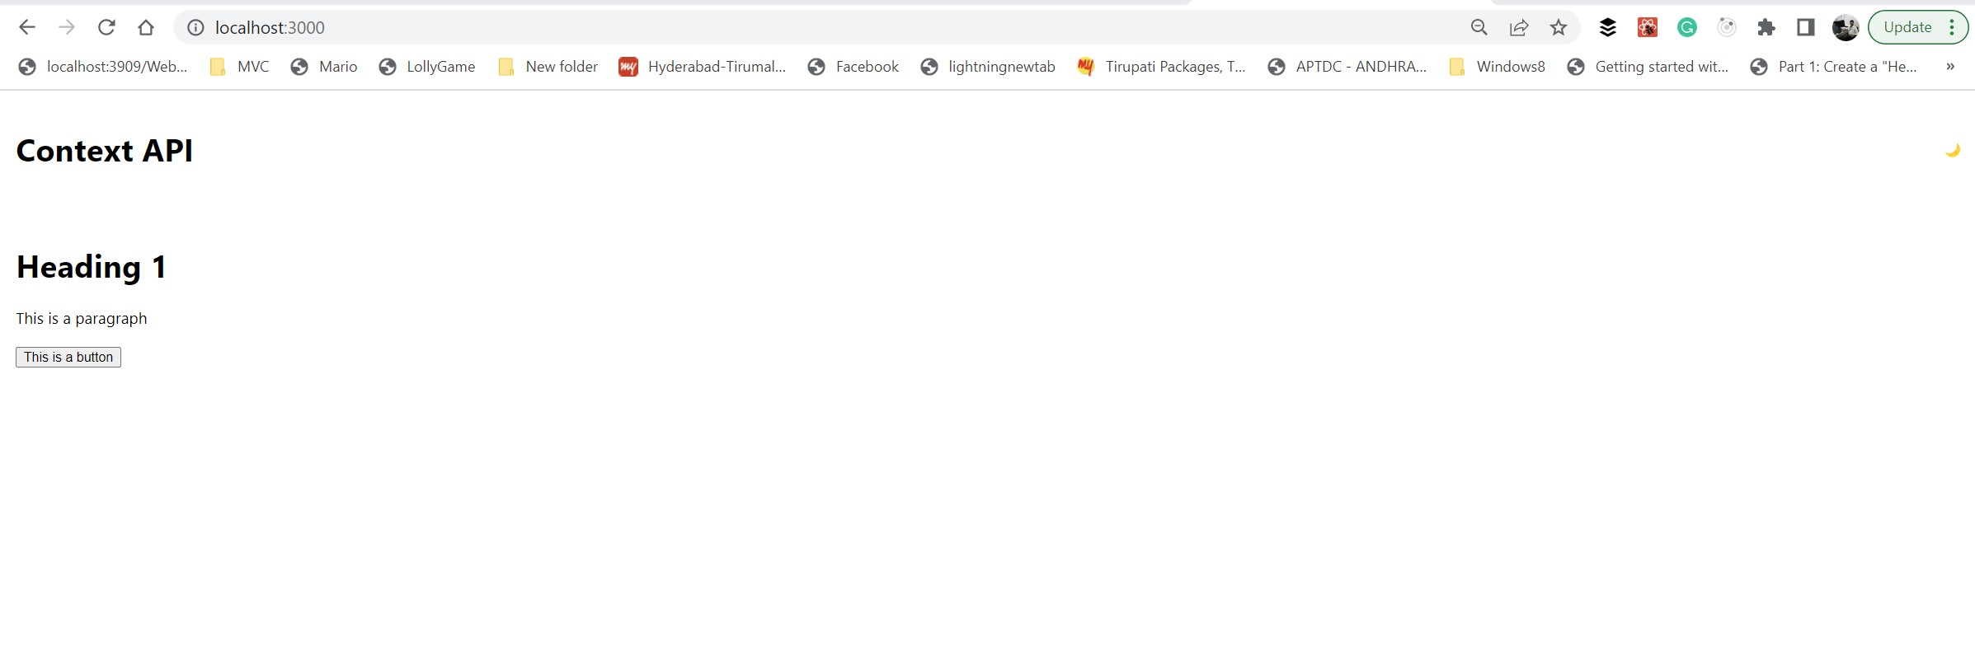
Run application and check output.

Slide 25
